Slide 1
DevOps
Ramaswamy Krishnan Chittur

Slide 2
DevOps
DevOps stands for ‘Software Development Operations’.
Key component of Software Development Life Cycle aimed at continuous delivery of the software with high quality.
Continuous integration (CI) is the process of automatically building and testing code every time a team member commits code changes to version control. See Use continuous integration - Azure DevOps | Microsoft Learn
One tool for DevOps is Azure DevOps: Azure DevOps Services | Microsoft Azure

Slide 3
Azure DevOps
The various features of Azure DevOps are:
Overview
Boards
Repos
Pipeline
Testing
Artifacts

Slide 4
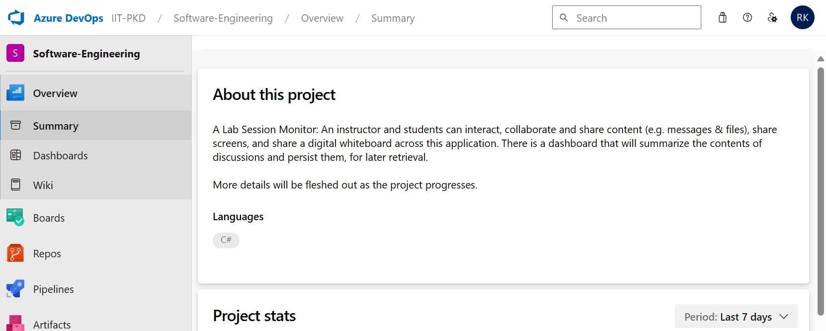
Azure DevOps: Overview
Overview provides options for summary, dashboards and wiki.
-

Slide 5
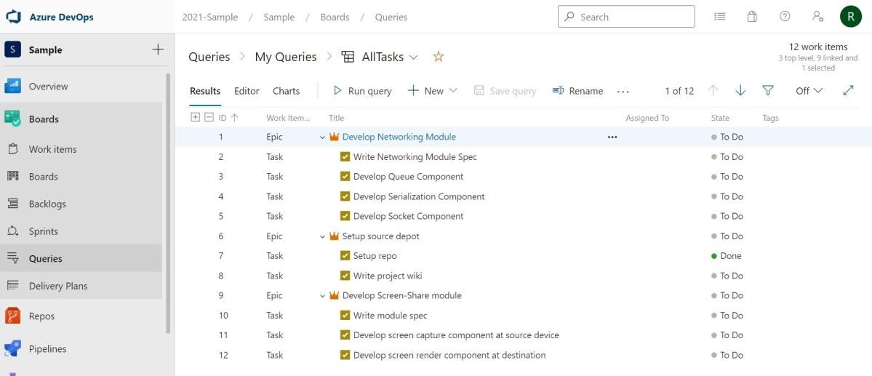
Azure DevOps: Boards
Provides project management tools.
-

Slide 6
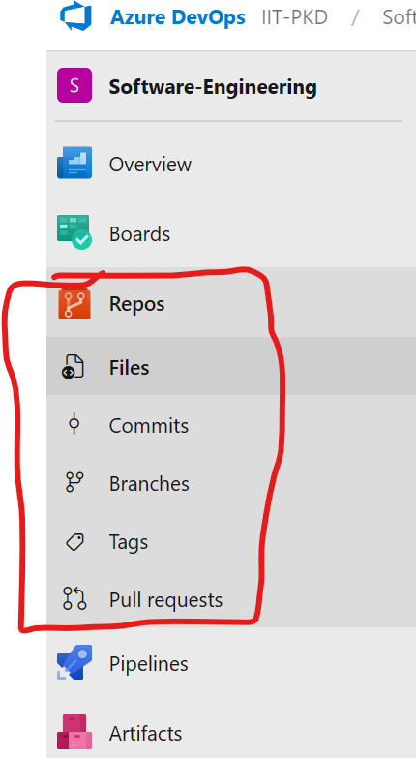
Azure DevOps: Repos
Is a source code repository with version control system.
-

Slide 7
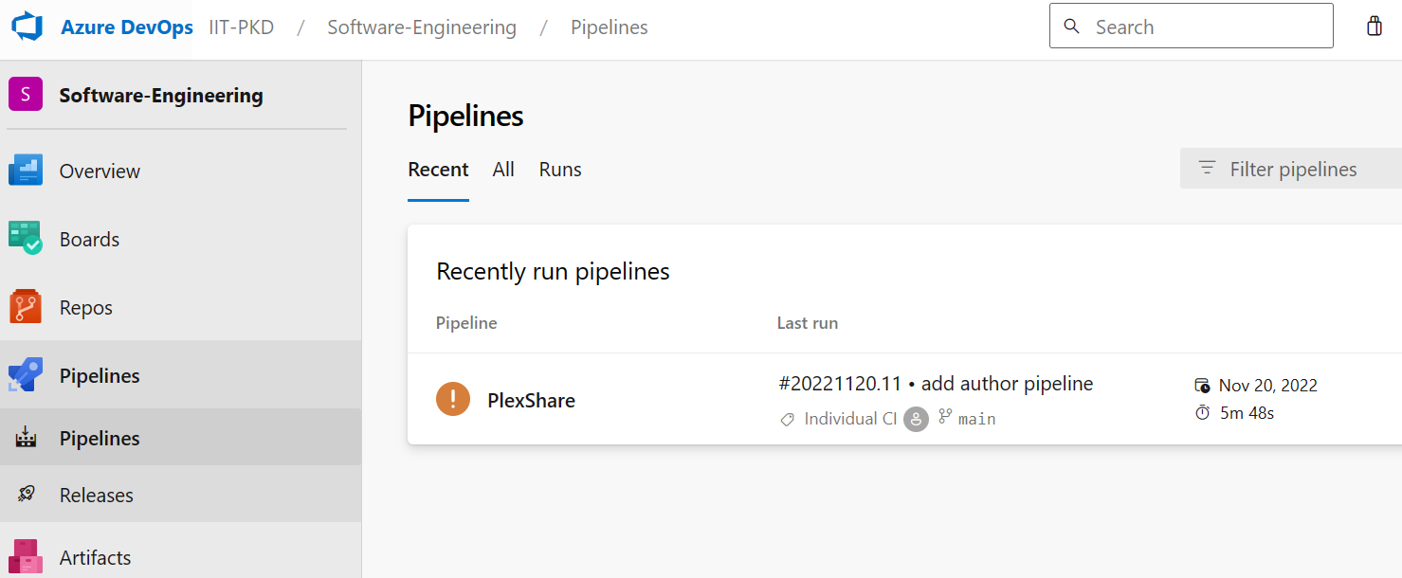
Azure DevOps: Pipelines
Enables creating workflows for continuous integration and continuous delivery.
-

Slide 8
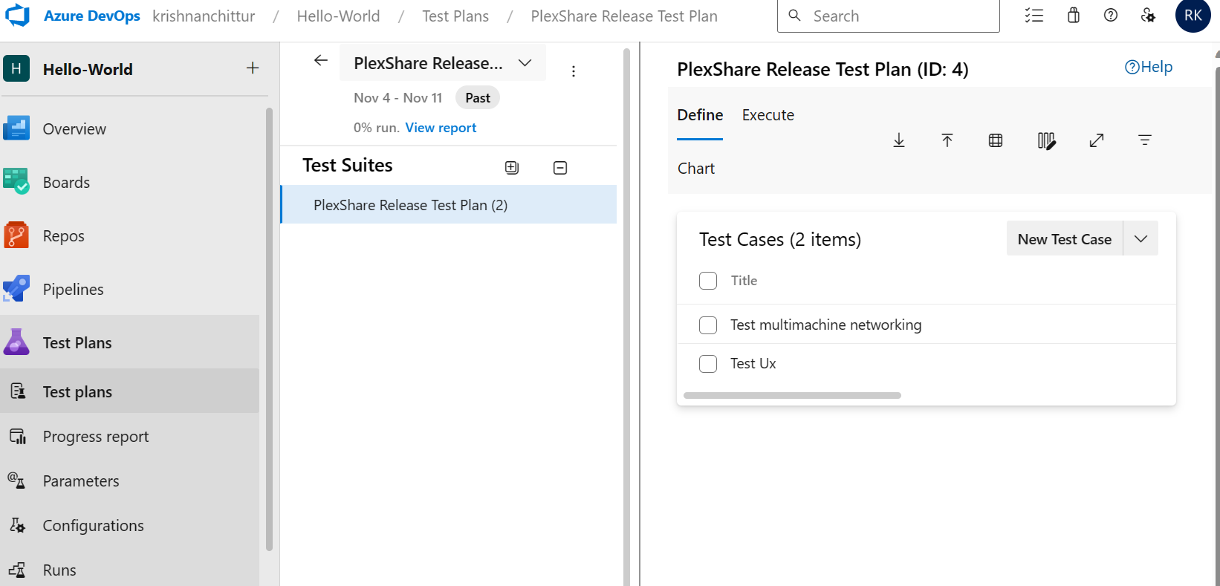
Azure DevOps: Test Plans
Enables authoring manual or automated test cases for End-To-End testing of the software product.
Also see: Shift testing left with unit tests - Azure DevOps | Microsoft Learn
-

Slide 9
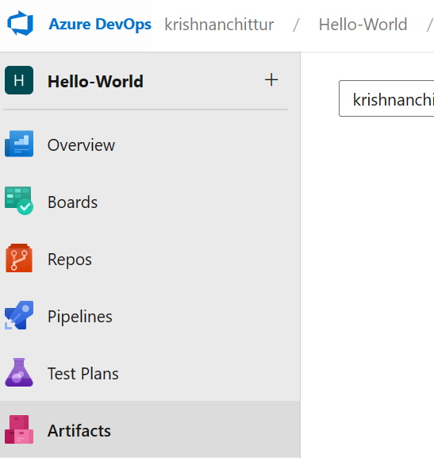
Azure DevOps: Artifacts
Enables developers to share and consume the packages like NuGet to include in project Azure pipelines.
-

Slide 10
Example
Azure Boards from one of the previous years’ student project: Work items - Boards (azure.com)

